Slide 1
Notebooks and Napari Widgets for Deep Learning
Brian Northan

Slide 2

Notebooks and Napari Widgets for Deep Learning

Slide 3

Notebooks and Napari Widgets for Deep Learning
Brian Northan
Contract R&D Engineer Imaging Processing True North Intelligent Algorithms
Contributor: ImageJ-Ops, CLIJ, Image.sc

Slide 4
Outline
Napari basics
Train/Validate on one image
with Napari ROIs

Slide 5
Outline
Sparse
Stardist with sparse labels
Scale
Cellpose at different scales
Stardist receptive field
thin protrusions
Lady bugs at different scales

Slide 6
Outline
Segment anything and everything (SAM)
visualizing overlapping SAM labels
Segment everything and filter

Slide 7
Instance segmentation

Slide 8
Links to projects used in this presentation
Link to slides
Course material from virtual I2k2024
tnia-python - My helper library

Slide 9
Links to projects used in this presentation
easy-augment-batch-dl deep learning on image sets with UNETs, Cellpose, Stardist, SAM and friends.
segment-everything - Utilities for rendering and training prompt-based and overlapping segmentation models (like SAM).
napari-segment-everything - This is a Napari GUI for segment-everything

Slide 10
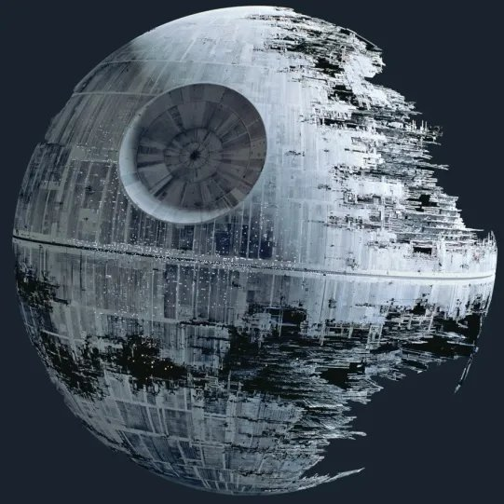
Under Construction

Slide 11
Training, Validation and Test sets
Training - data that is input to the model
ideally get almost ‘perfect’ results when predicting on training set
Validation
Data not fed to model
used to tune parameters during training.
Test
unseen partition
used to evaluate how well model generalize

Slide 12
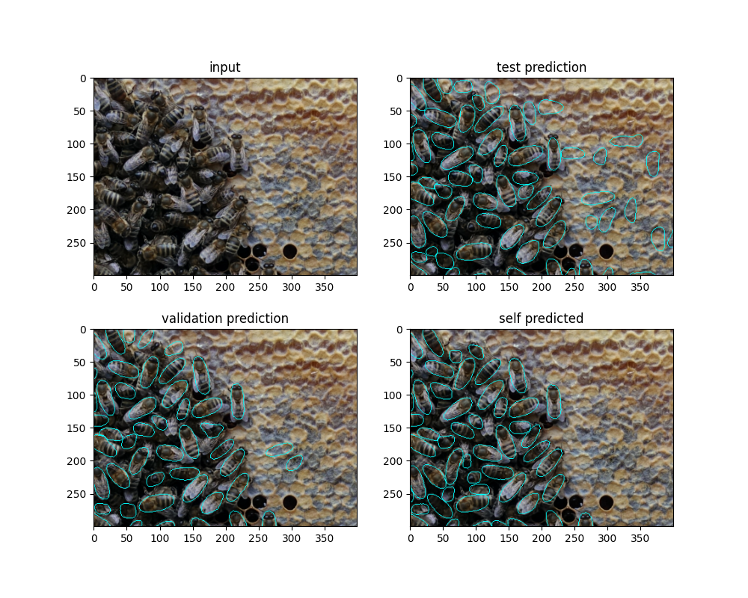
Bee Predictions

Slide 13
Napari basics

Slide 14
Why use Napari for DL workflows ?
ROIs
Layers
Labelling tools

Slide 15
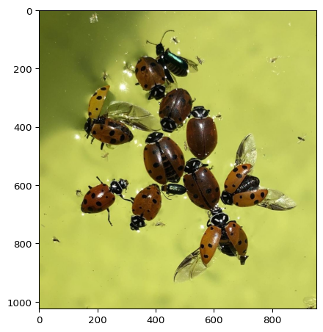
Test image

Slide 16
Start Napari and add layers
viewer = napari.Viewer() labels = np.zeros([img.shape[0], img.shape[1]], dtype=np.uint16) viewer.add_image(img, name='ladybug') viewer.add_labels(labels, name='labels') rois_layer = viewer.add_shapes(face_color='transparent', edge_width=15, edge_color='blue', name='rois') box = [[100,100], [100,800],[800,800], [800,100]] rois_layer.add_rectangles(box)

Slide 17
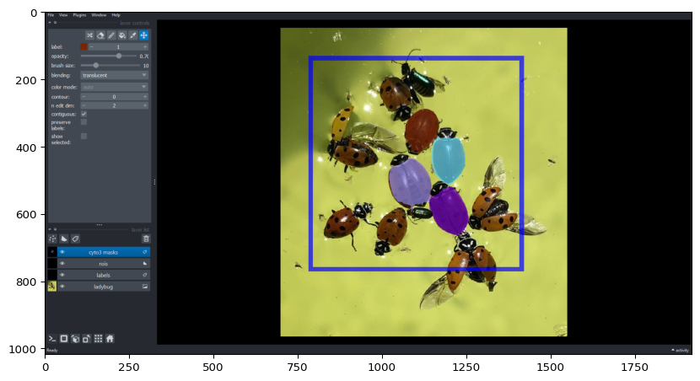
Add a cellpose layer
from cellpose import models, io model_cyto3 = models.CellposeModel(gpu=True, model_type="cyto3") results = np.zeros([img.shape[0], img.shape[1]], dtype=np.uint16) viewer.add_labels(results, name='cyto3 masks') results = model_cyto3.eval(img, diameter=140) viewer.layers['cyto3 masks'].data = results[0]

Slide 18
Train and test model on a single image

Slide 19
Why?
Proof of concept
Grants, SBIRs
Data sharing restrictions

Slide 20
How?
Can’t just train/predict on same image
Use ROIs to divide image into training/validation

Slide 21
Train and test model on a single image
Explore and label data with napari-easy-augment-batch-dl
draw and label ROIs
Augment and crop to create patches (hundreds)
Train
Predict and fix mistakes

Slide 22
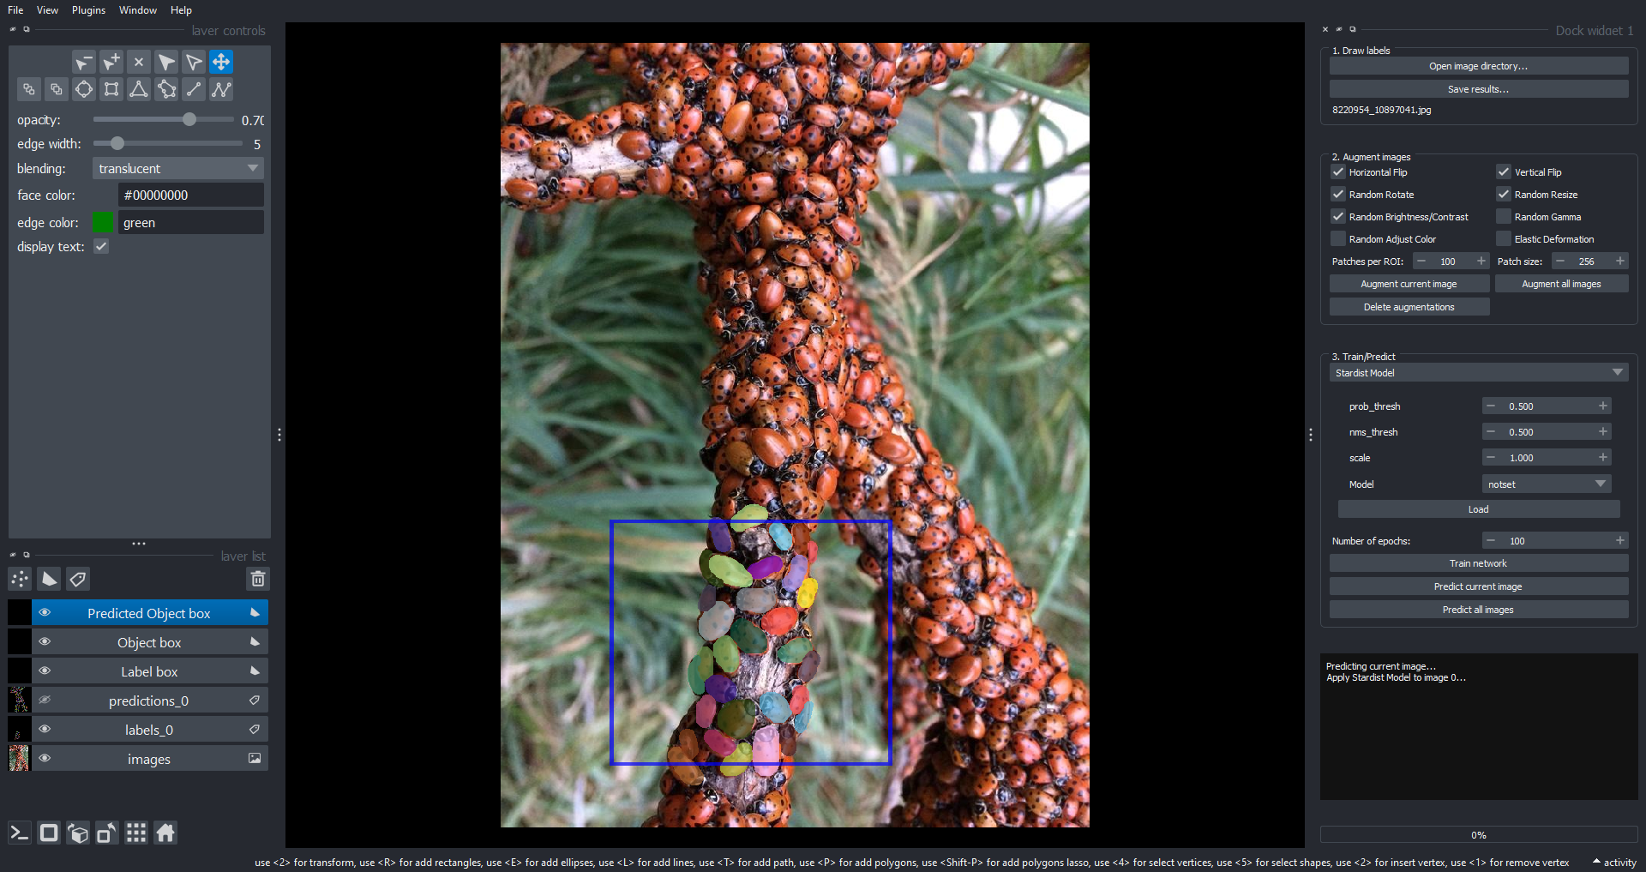

Slide 23
Augmentation
From single label can genrate hundred of augmented patches
Flip, rotate, resize
Random adjust brightness/contrast
Random adjust gamma
Color jitter
Elastic transform

Slide 24
Augmentation
Save explicitly?
can be helpful for troubleshooting, performance and repeatability
Augment ‘inline’
More variation, save diskspace

Slide 25
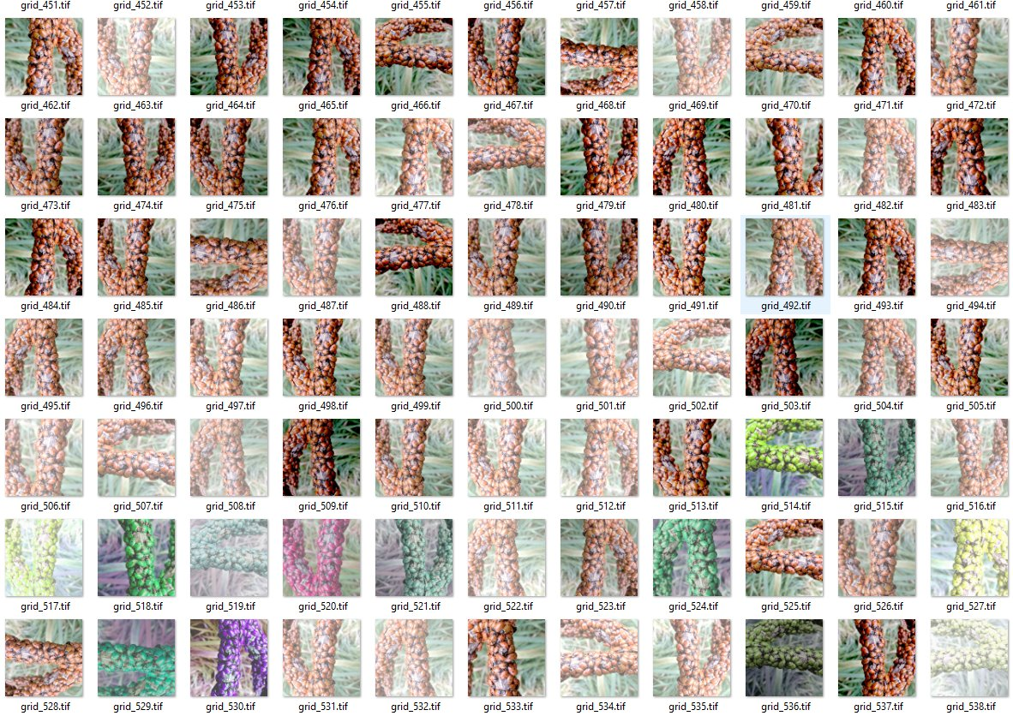

Slide 26
Train
train on augmented patches

Slide 27
Prediction
after training go back and predict
correct mistakes

Slide 29
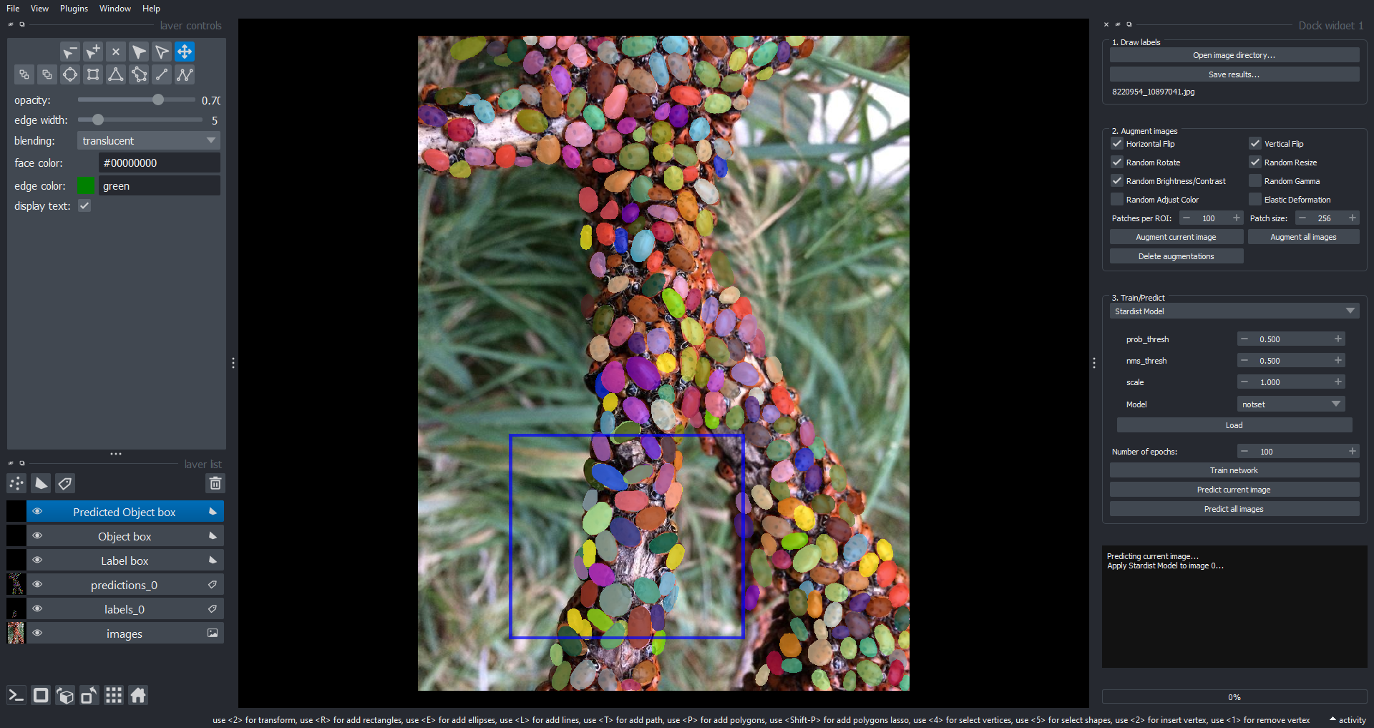

Slide 30
Sparse Labeling
See CellSparse discusion

Slide 31
Instance Labeling
2 groups
Objects (assigned unique index)
background (no index)
Need to label everything in a patch

Slide 33
Sparse Labeling
3 groups
Objects
Background
Not labeled

Slide 34
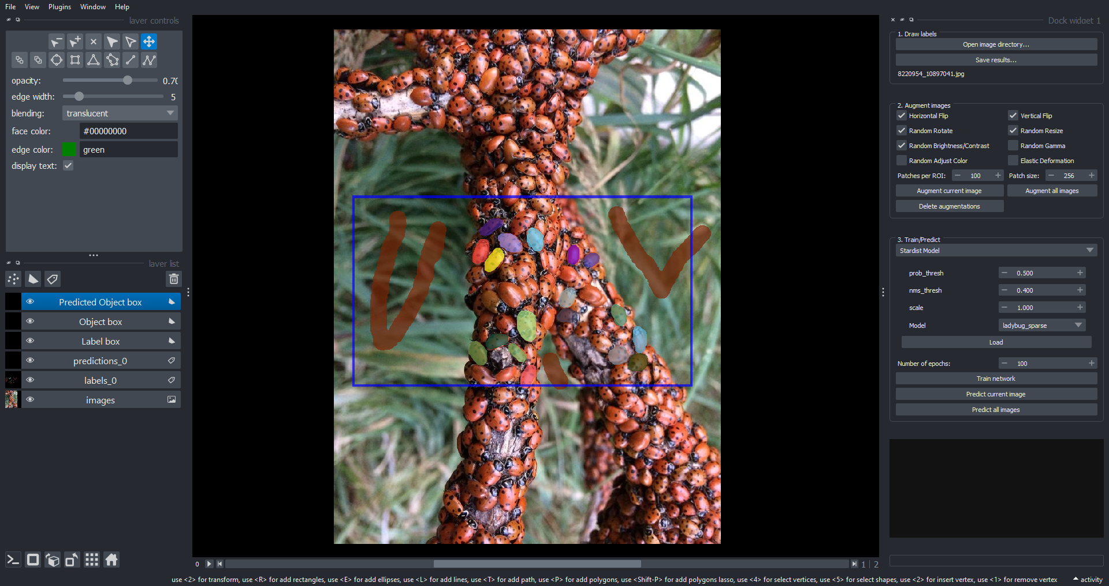

Slide 36
Sparse labeling
Why ?
Save work
Better sampling

Slide 37
Sparse Labeling
Why not ?
Fewer ‘edges’ between tightly clustered objects.

Slide 38
Sparse Labels

Slide 40
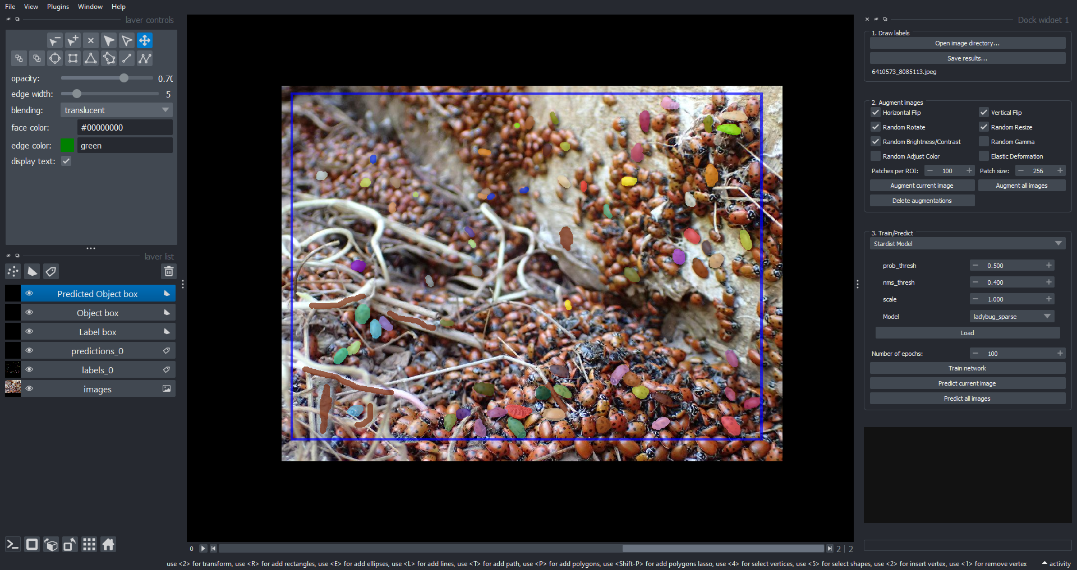

Slide 41
And the predictions

Slide 42
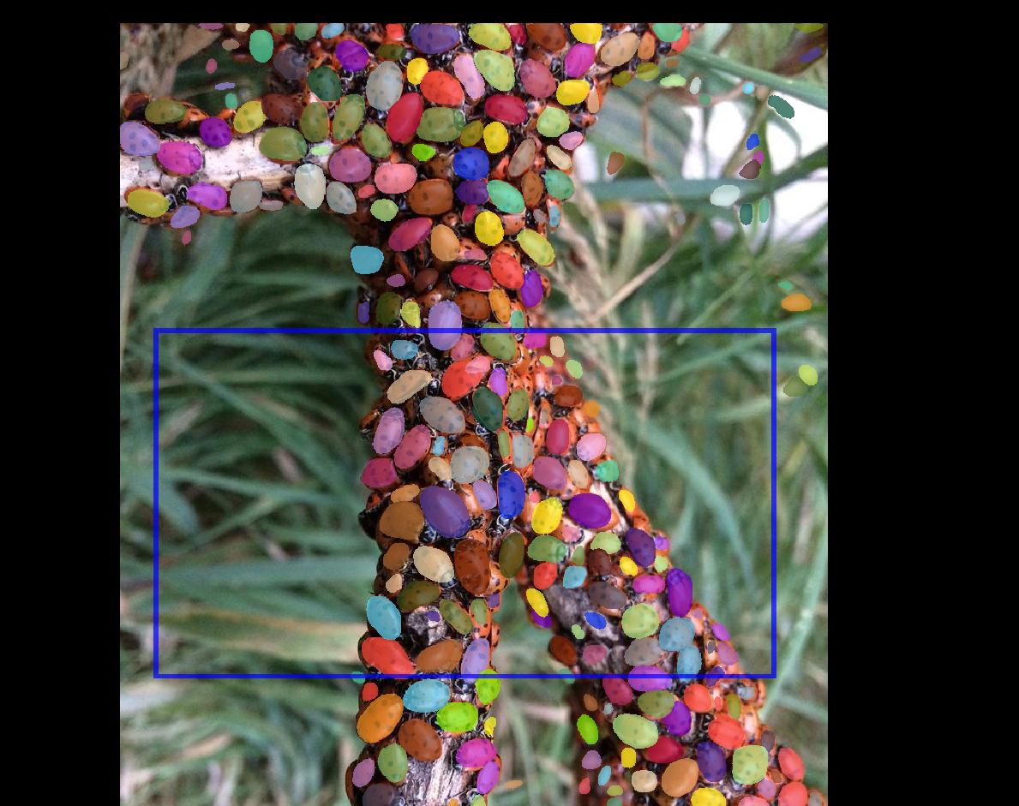

Slide 43
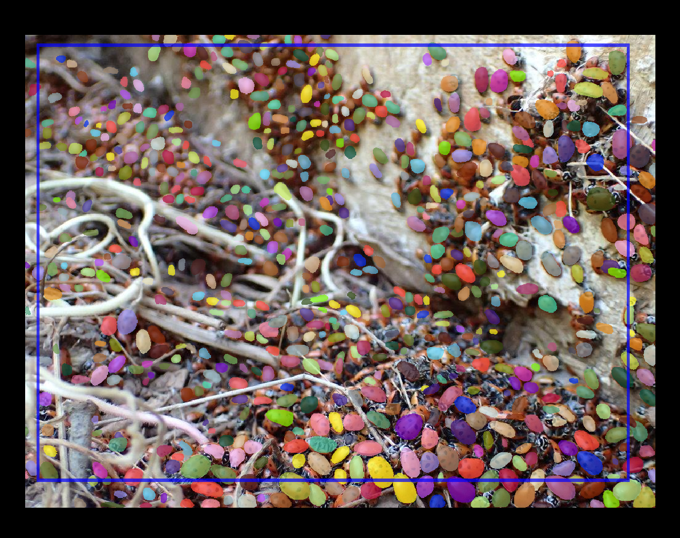

Slide 44
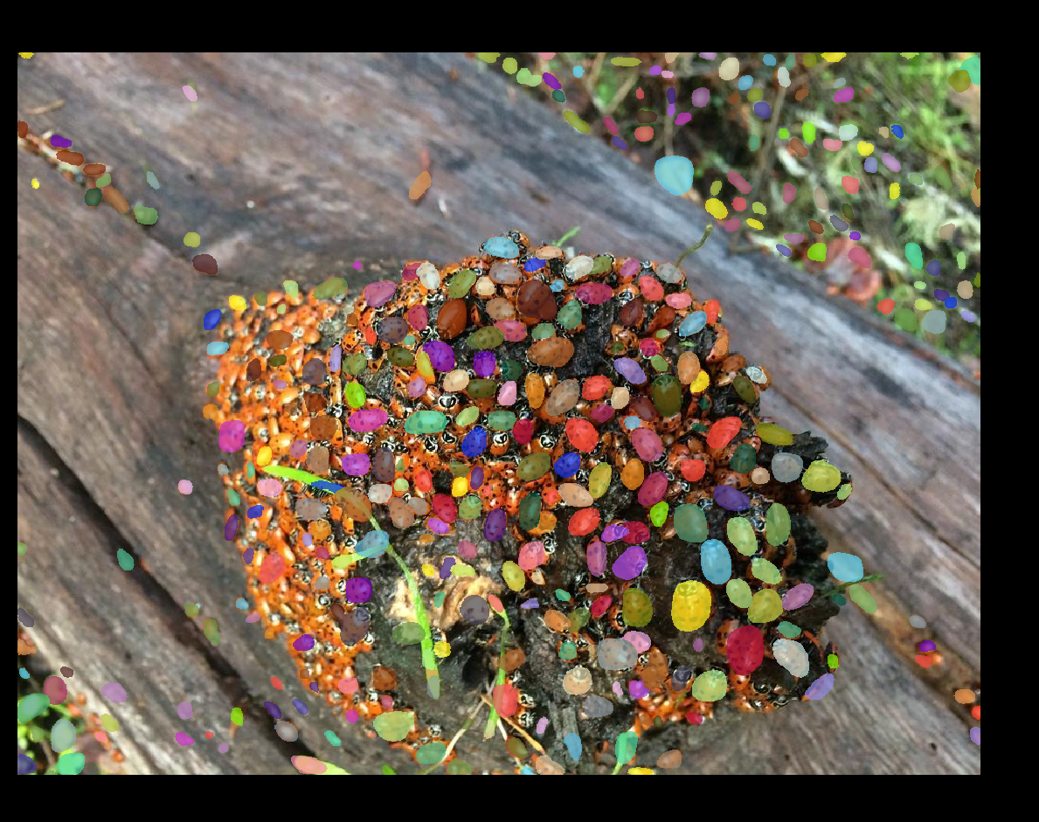

Slide 45
Cellpose trained to learn scale
Use same Cellpose model to detect spheres of varying sizes in the same image
Common to use diameter parameter to rescale image
May not work if different scales in the same image

Slide 46
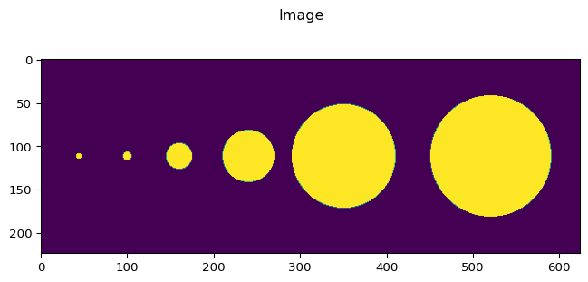
Phantom Image

Slide 47
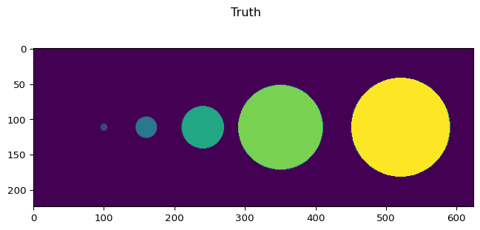

Slide 48
Process with Cyto2 and different diameters

Slide 49
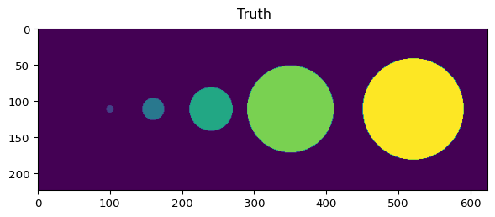
diameter=6

Slide 50
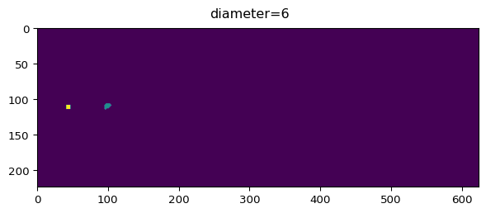

Slide 51
diameter=30

Slide 52
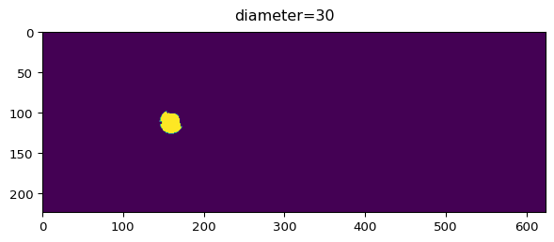

Slide 53
diameter=70

Slide 54
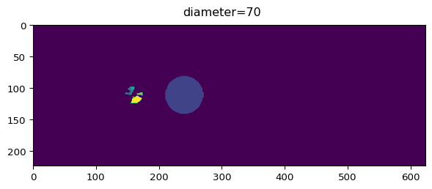

Slide 55
diameter = 140

Slide 56
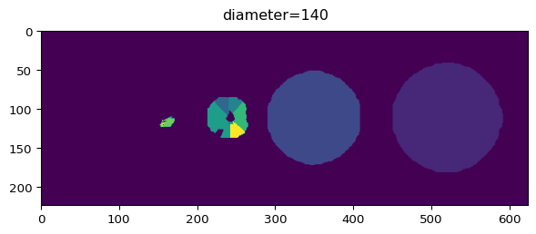

Slide 57
Train custom model
train.train_seg(model_custom.net, X, Y, channels=[0,0], save_path=model_path, n_epochs=180, min_train_masks=1, normalize = False, rescale = False, model_name=model_name)

Slide 58
Custom model (diameter=30)

Slide 59
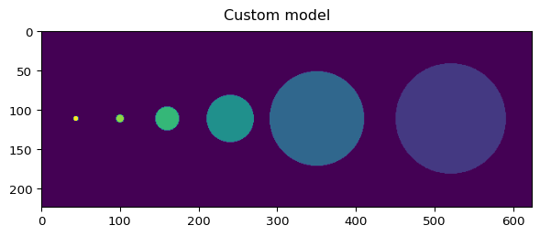

Slide 60
Stardist receptive field
region of input that influences output
impacted by striding, kernel size and number of layers

Slide 61
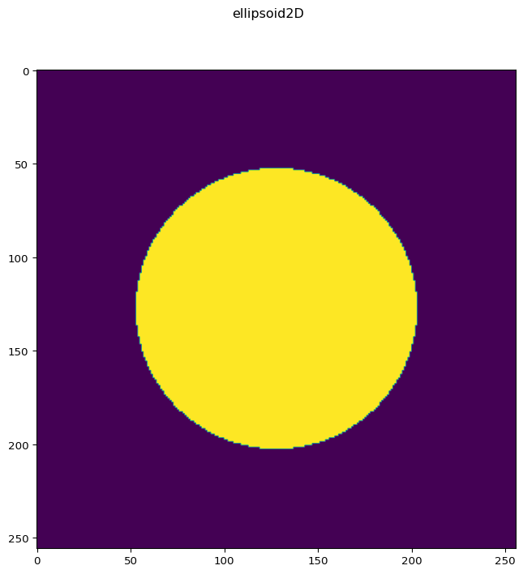
Create a 2D Object

Slide 62
Design Stardist 2D Network
Larger grid
means larger stride thus ‘see’s’ more 1st level
Larger kernel
see’s more each level
More levels
each level images are downsampled
kernels at that level process larger spacial region

Slide 63
Empiricaly measure receptive field
see stardist 3D training example notebook
applies the model to a single point
measures how far information - flows
doesn’t matter if the network has been trained
just interested in information flow

Slide 64
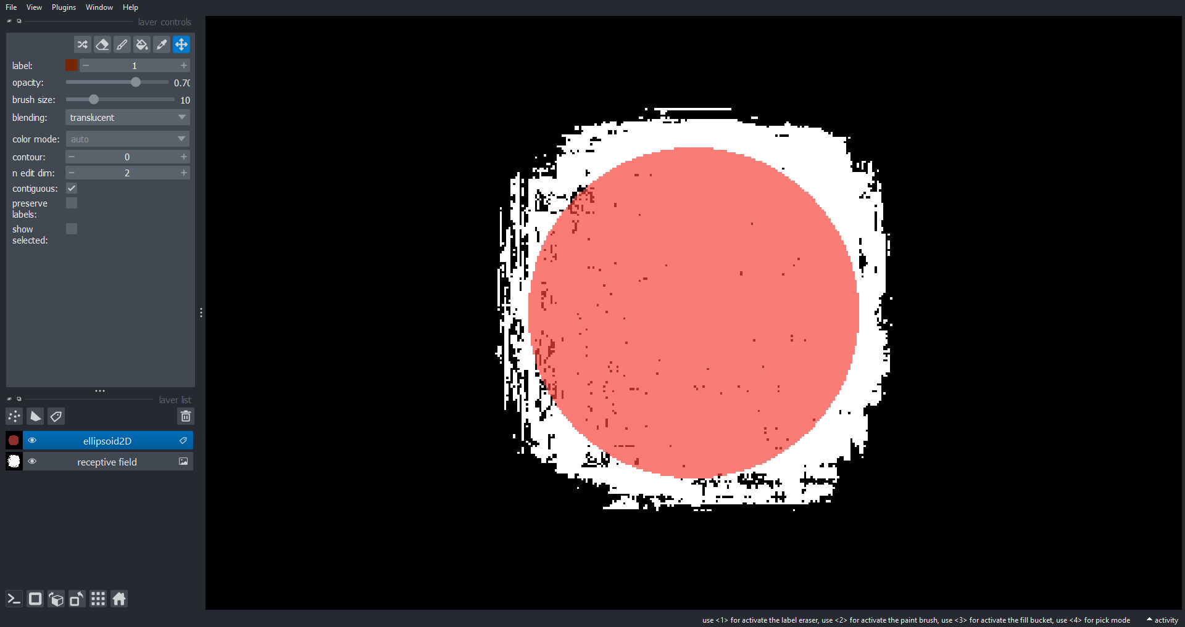

Slide 65
Large objects with protrusions
Image set courtesy of Arkajyoti Sarkar
See this Image.sc question
Combination of large cells and long fine irregular protrusions

Slide 66
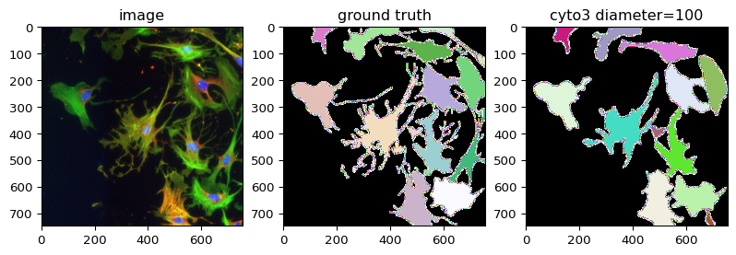
Cyto3 Results

Slide 67
Challenges and considerations
Need to retrain to detect protrusions better
Cellpose rescales during training which could result in some loss of fine features.
Receptive field? During training and prediction do we need the entire cell and protrusions in receptive field of neural network?
Receptive field may be more important in stardist, Cellpose ‘seems’ to predict good flows with tiling.

Slide 68
Self-prediction
Train on one image, predict on same image.
Not going to get good generalization this way!
but… a useful experiment to determine if model can code structure of interest.
Try to tune parameters to get ‘perfect’ self-prediction then move on to training a real model that generalizes.

Slide 69
Training Strategy
Turn rescaling off to avoid losing resolution and this features.
Use larger bsize (crop size) to get more information in each training patch.
(turned out this may not be that important)

Slide 70
Training code
train.train_seg( model_finetuned_no_rescale_bsize_512.net, X_list, Y_list, channels=[2,3], save_path=parent_path, n_epochs=500, min_train_masks=0, rescale = False, model_name='no_rescale_bsize_512', normalize=False, bsize=512)

Slide 71
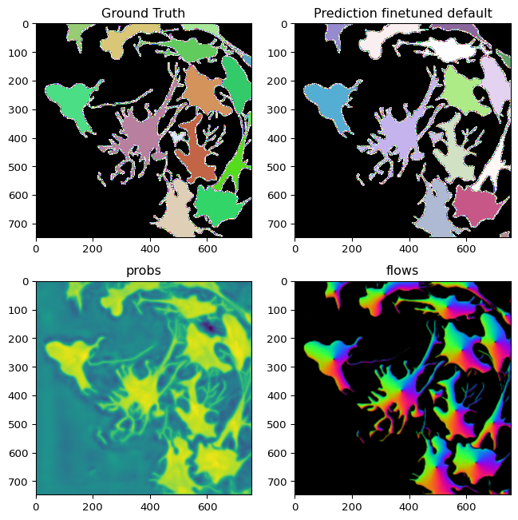
Retrained defaults

Slide 72
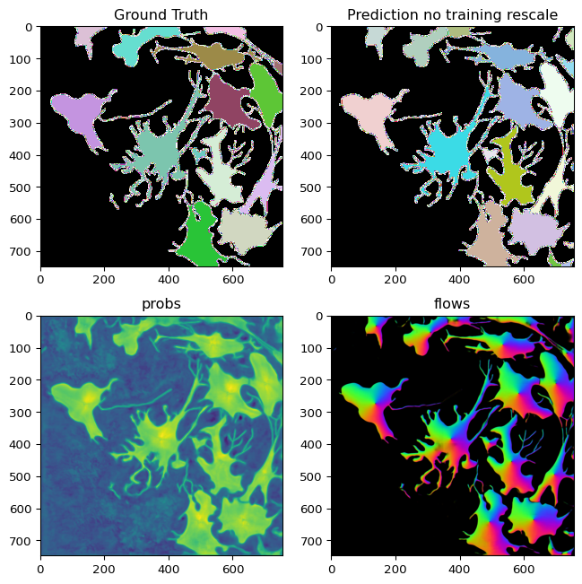
Retrained no rescaling

Slide 73
Model training on sequence
140 images
10 labeled
no rescaling during training
bsize = 512
niter = 5000 during prediction

Slide 74
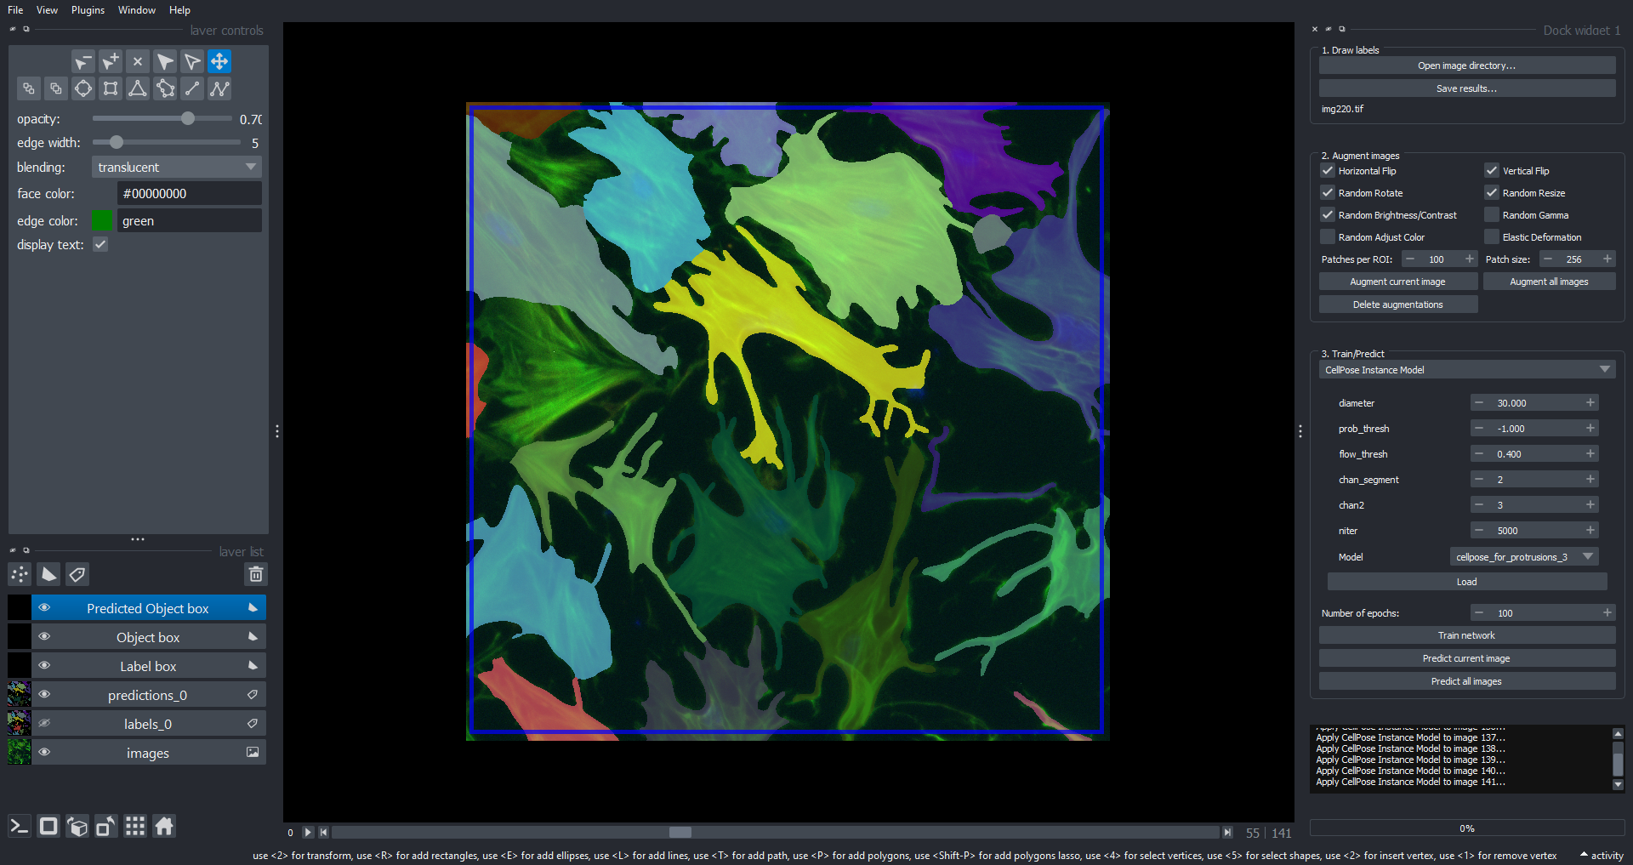
Model training on sequence

Slide 75
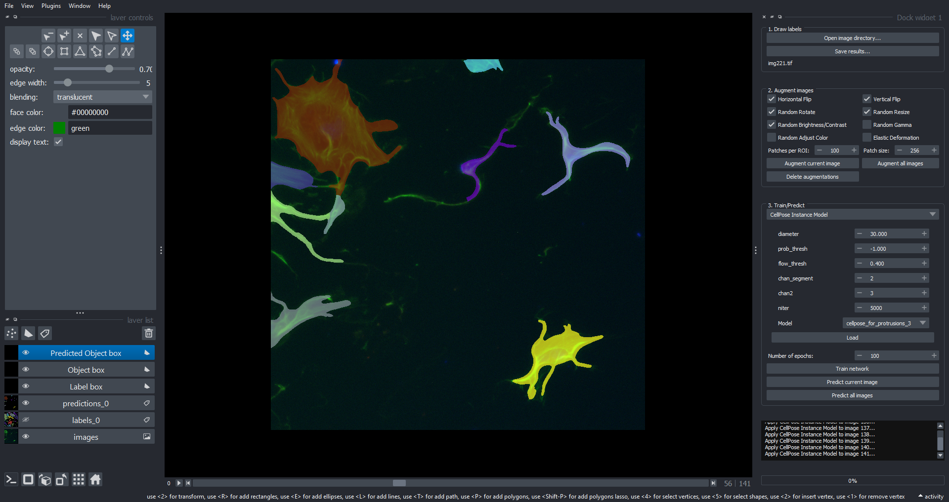
Model training on sequence

Slide 76
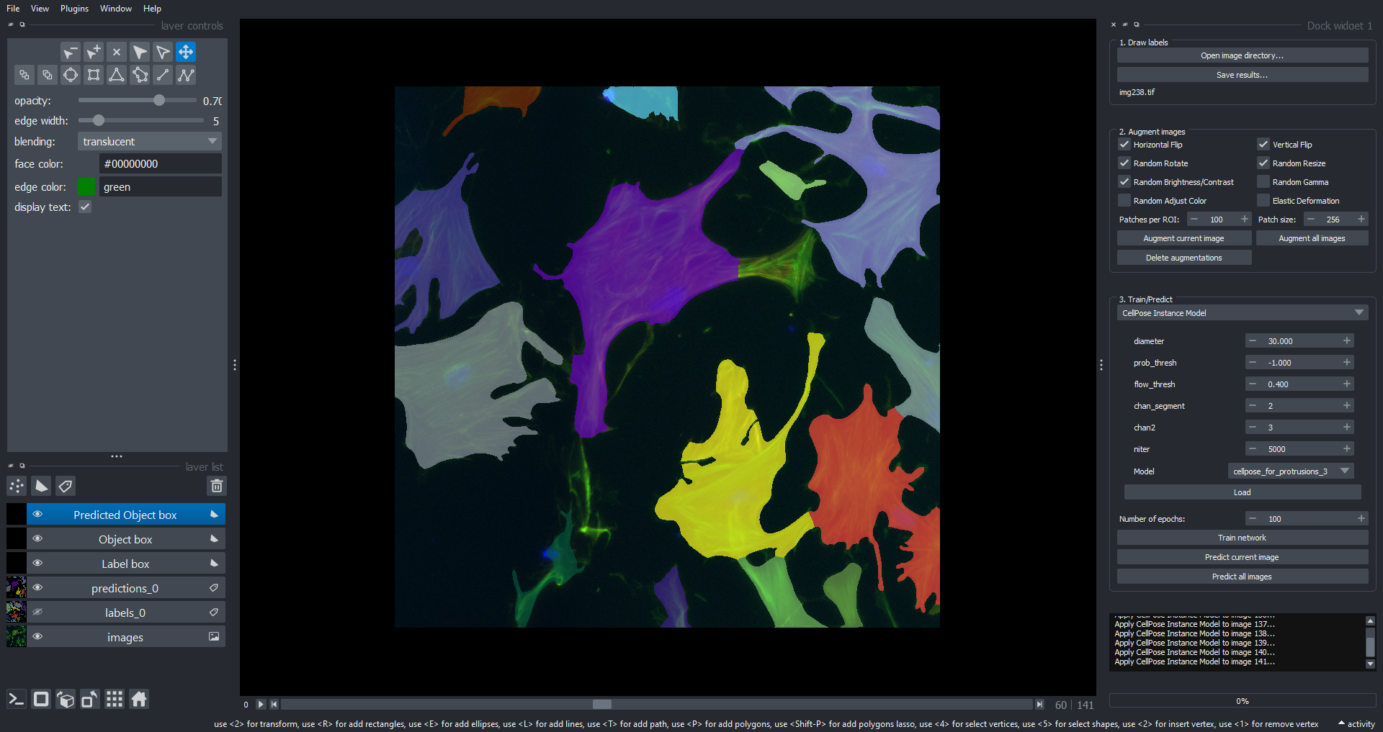
Model training on sequence

Slide 77
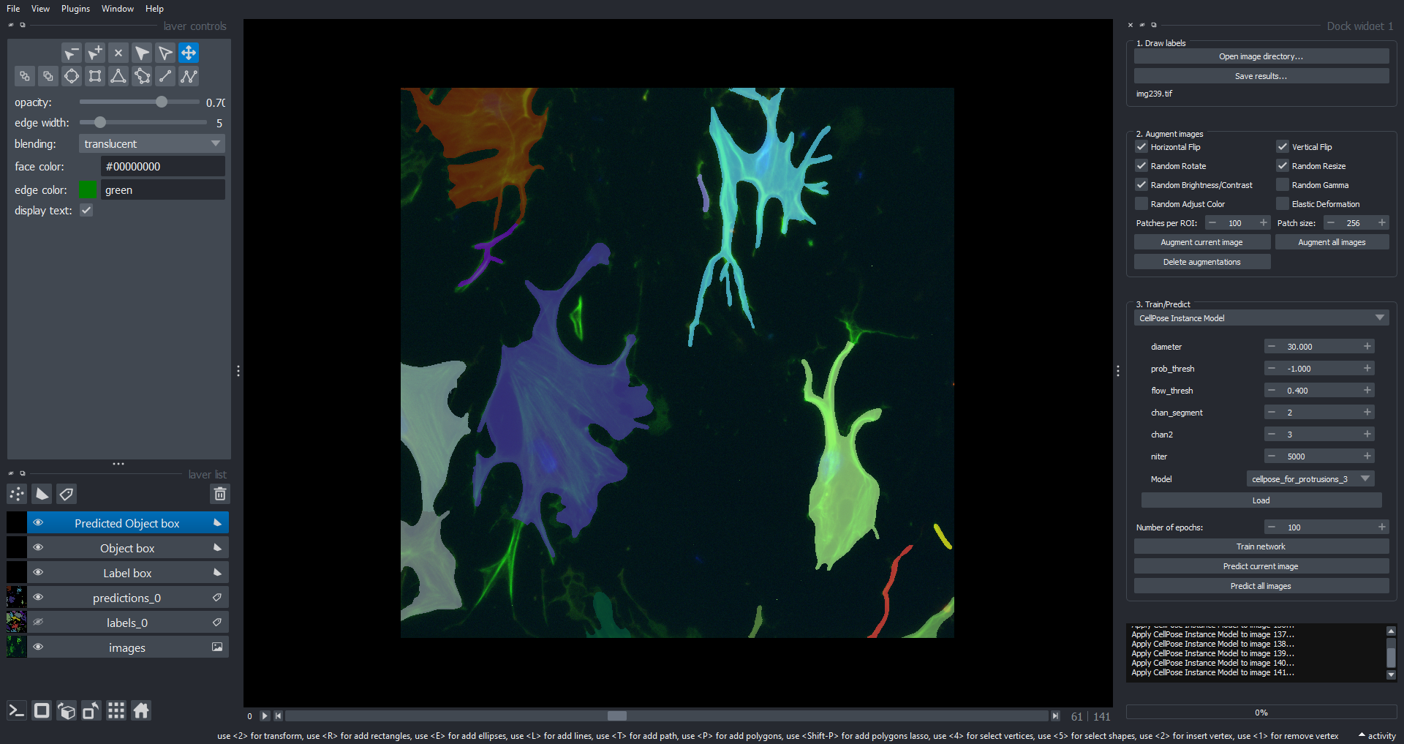
Model training on sequence

Slide 78
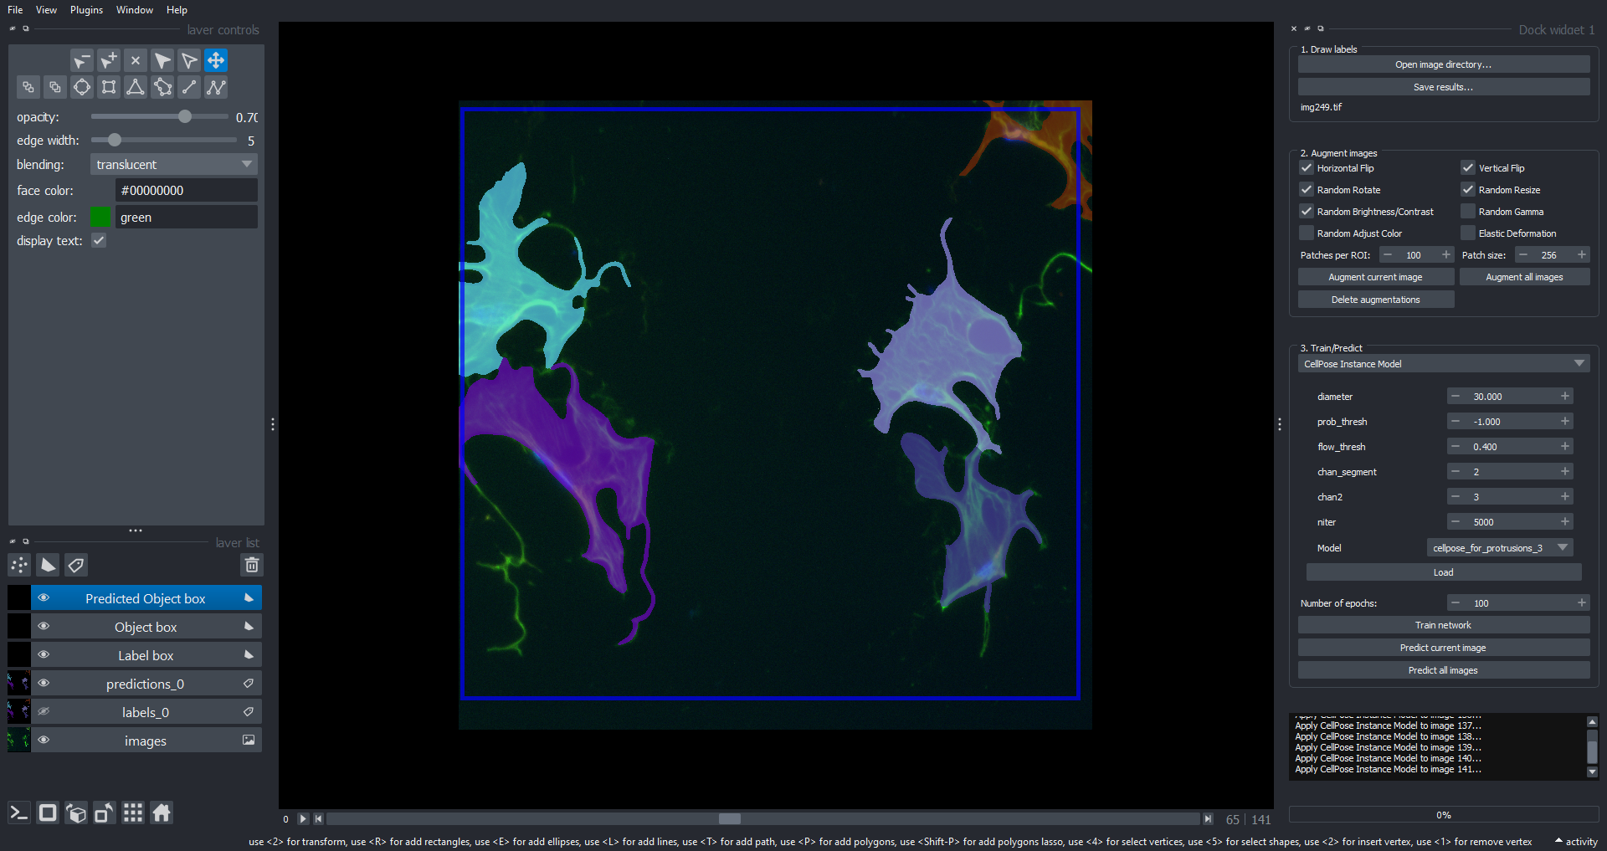
Model training on sequence

Slide 79
Ladybugs at different scales

Slide 80
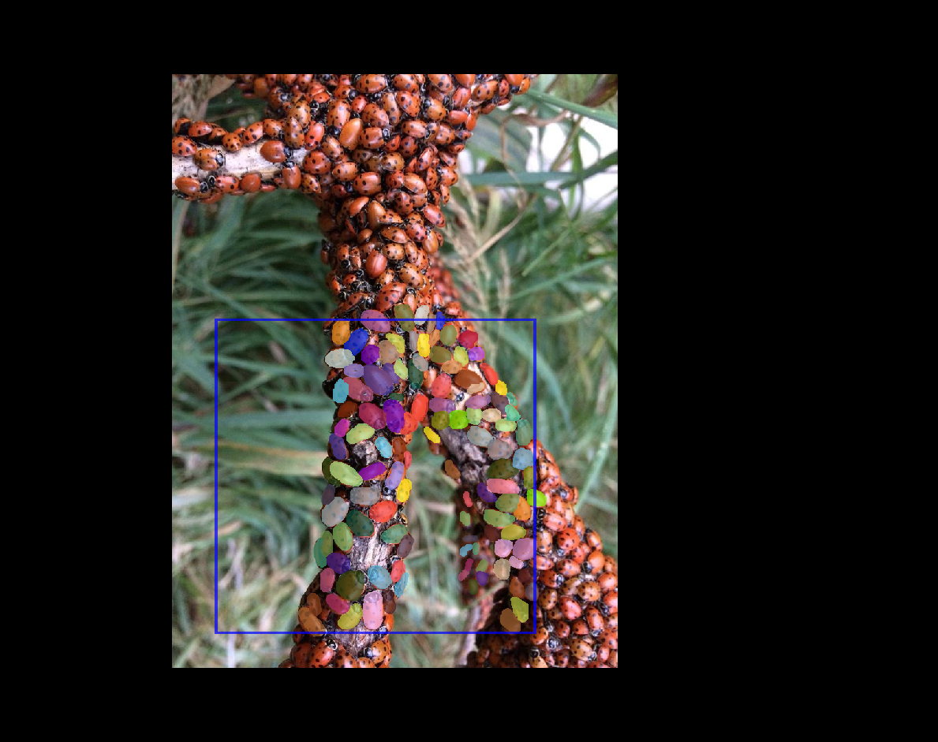

Slide 81
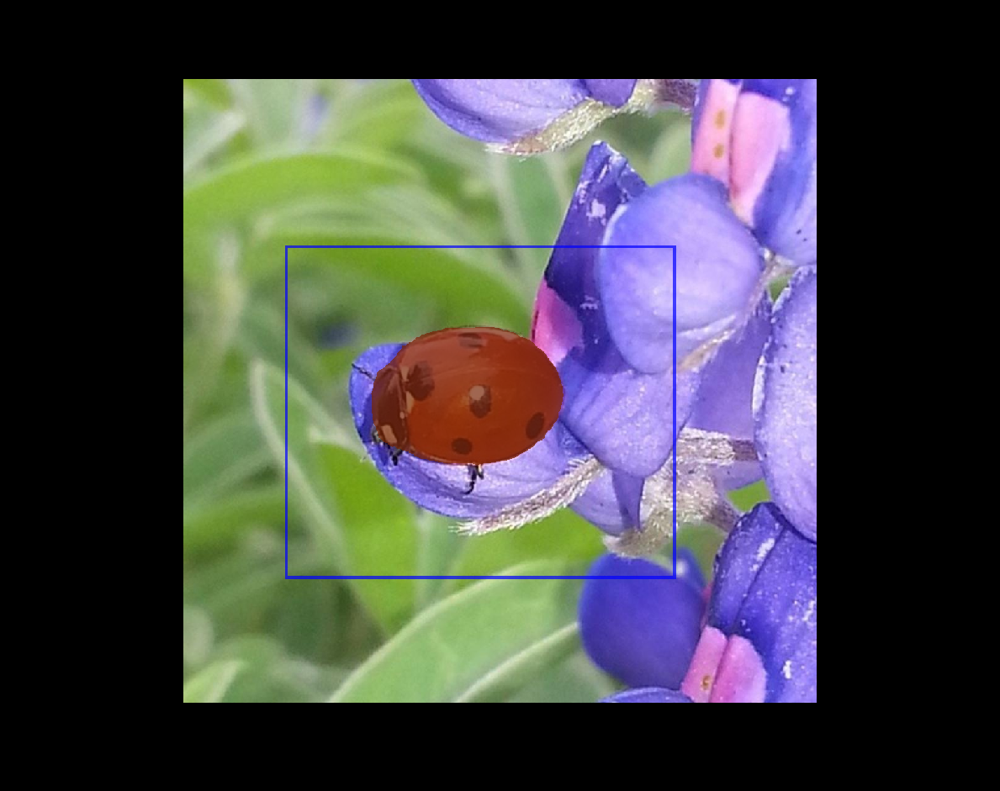

Slide 82
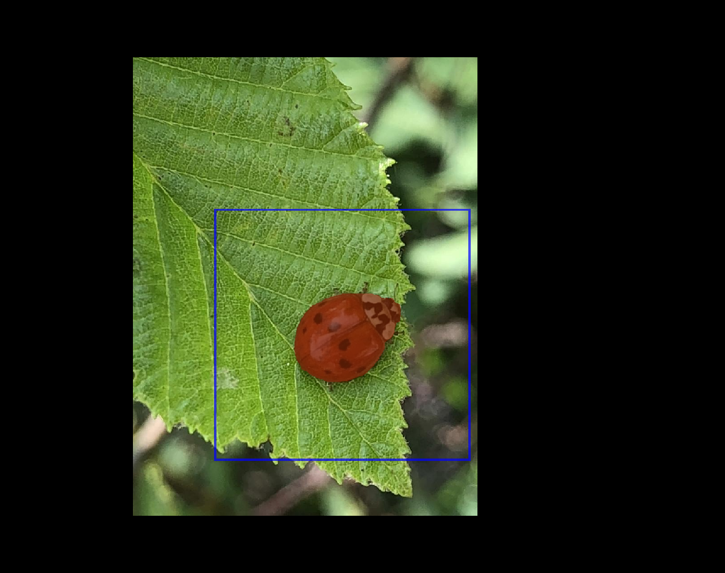

Slide 83
How to handle this ?
Scale related parameters
Cellpose diameter
Stardist scale
What if hundreds of images ?
Can we train for different scales ?

Slide 84
Self-Prediction
predict the training set

Slide 85
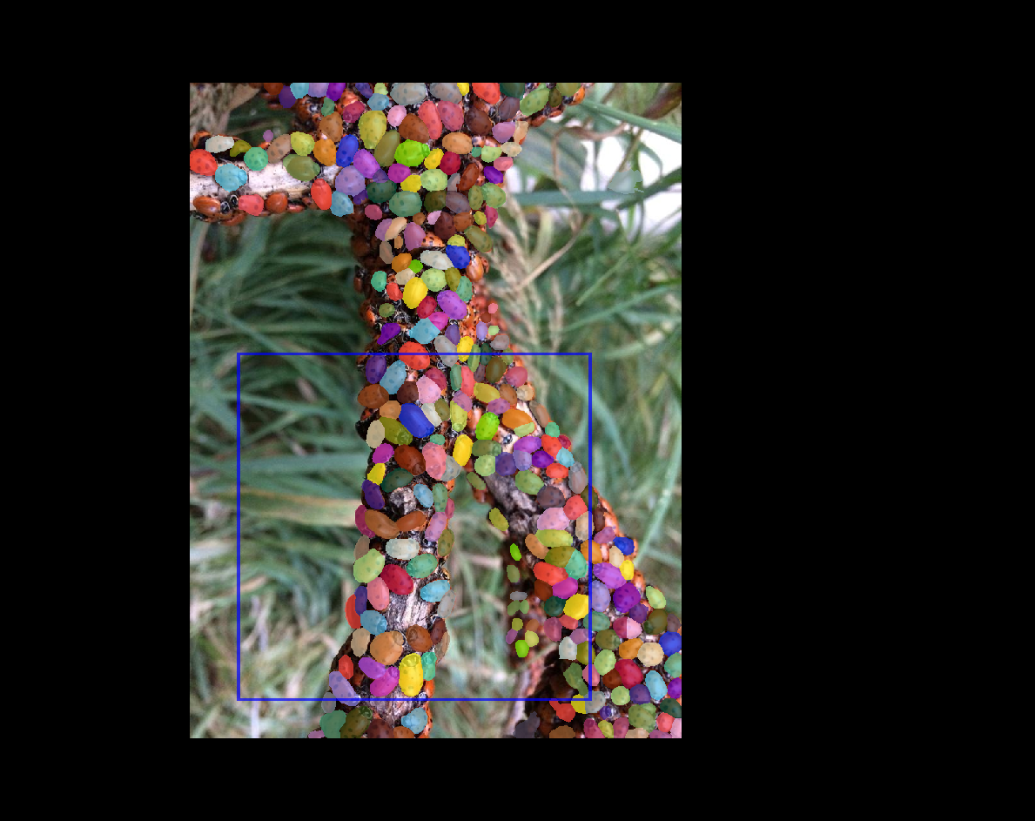

Slide 86
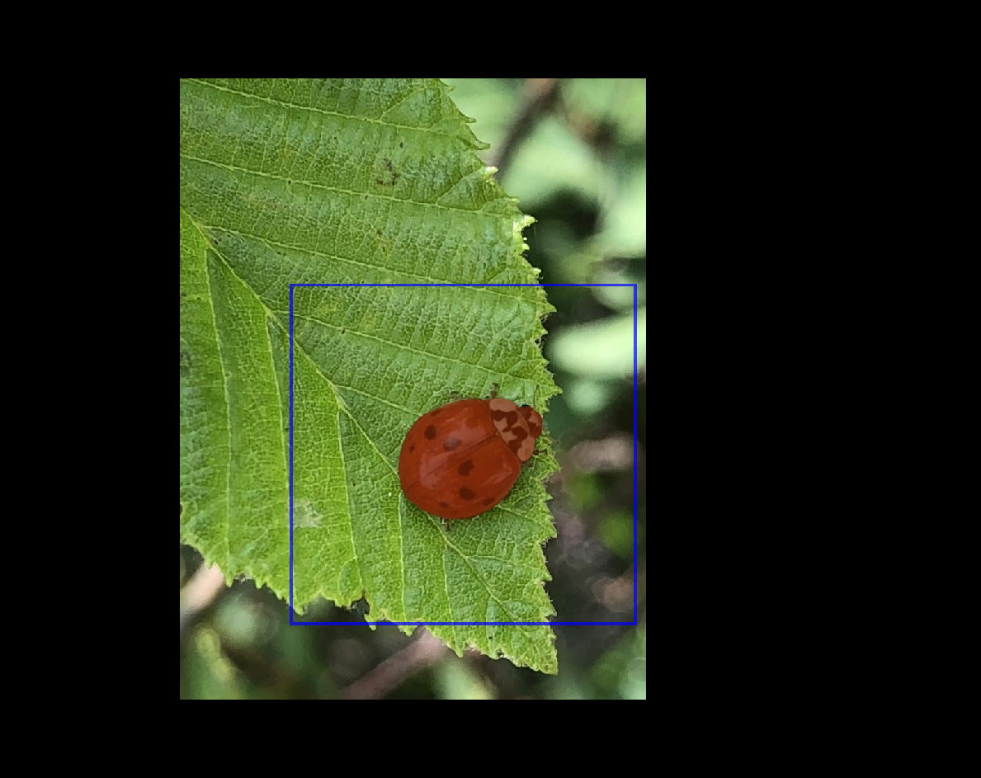

Slide 87


Slide 88
Validation
predict other images in series

Slide 89
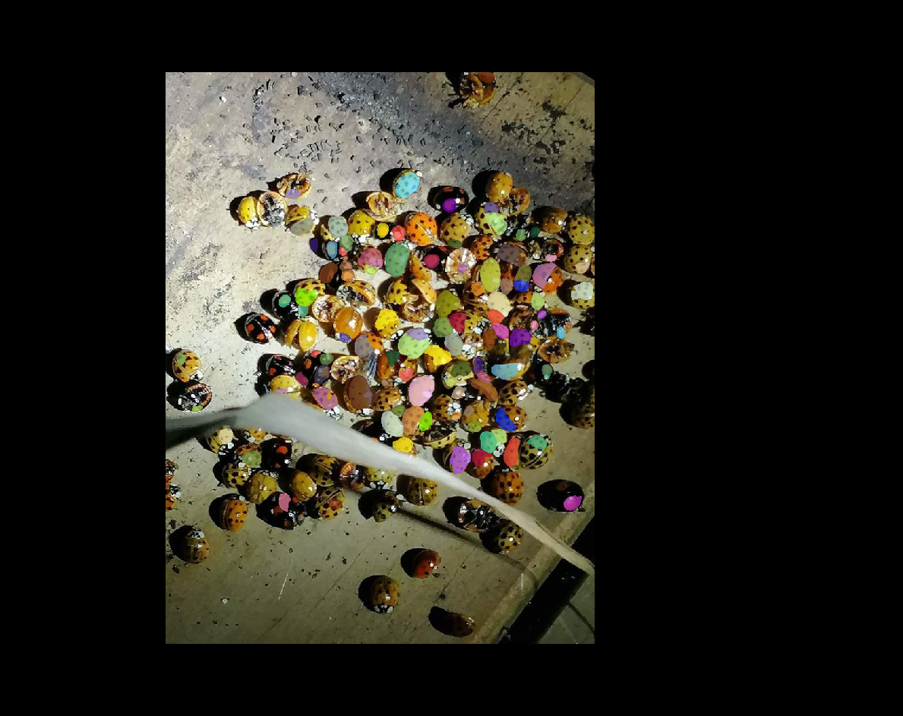

Slide 90
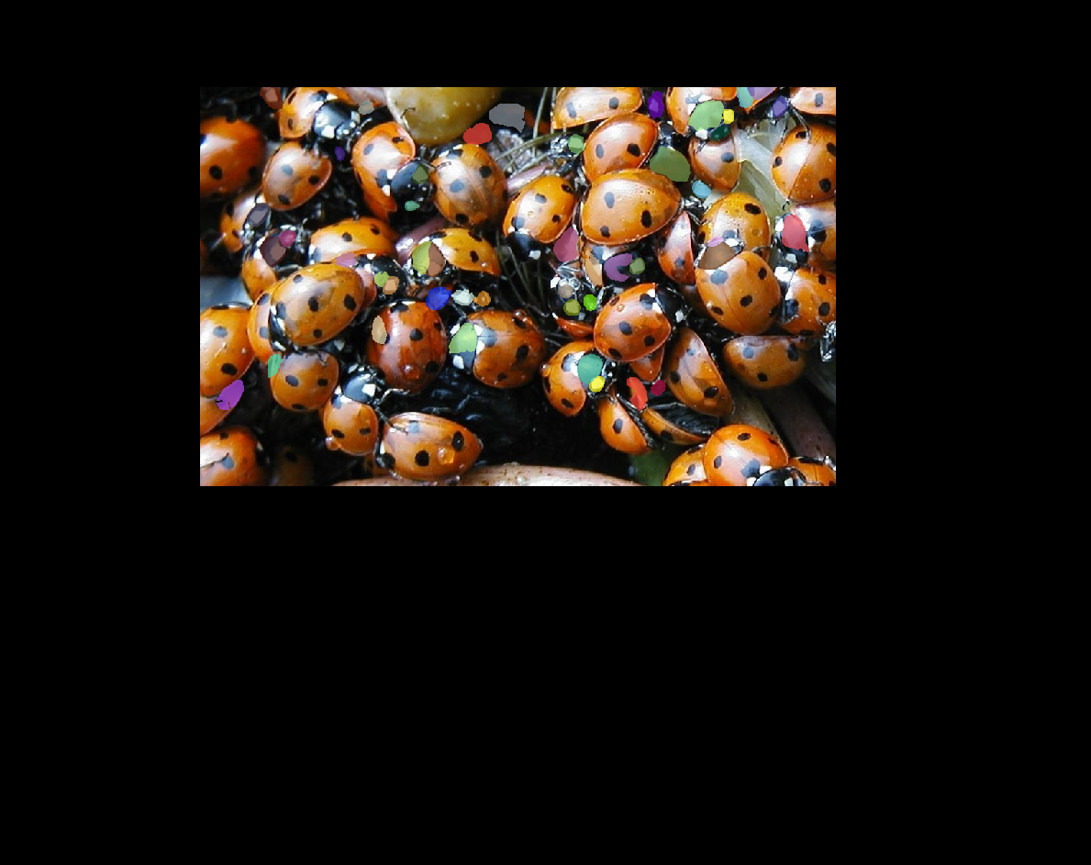

Slide 91
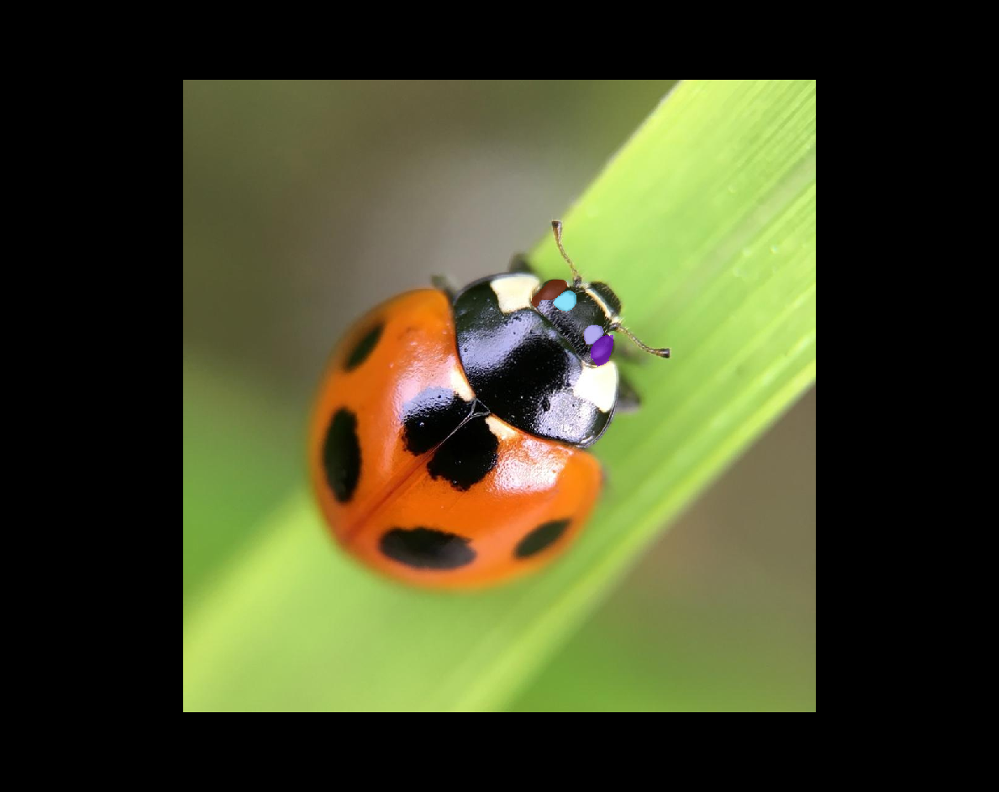

Slide 92
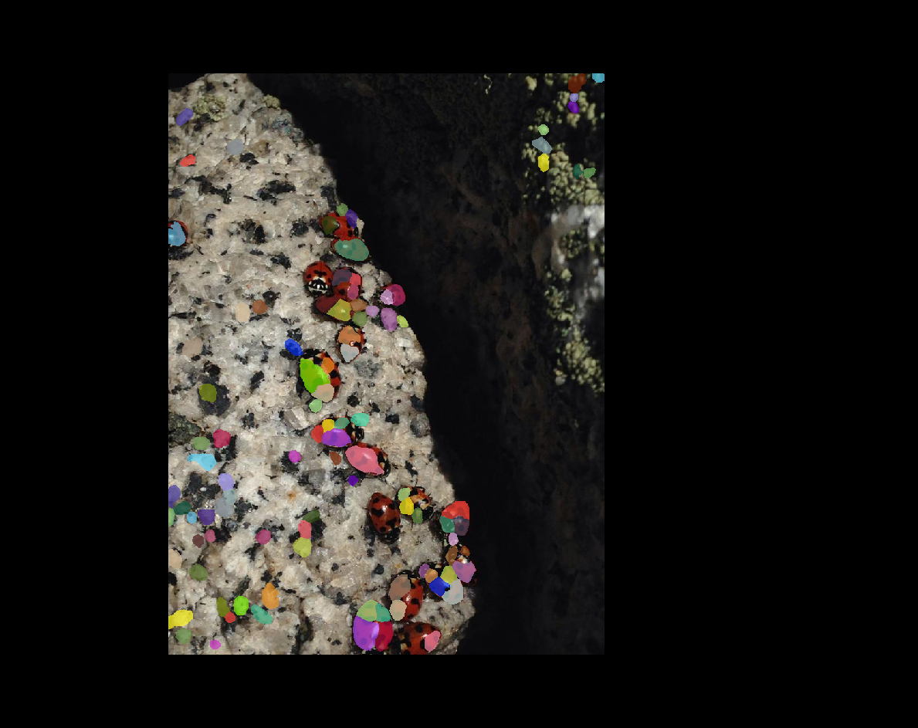

Slide 93
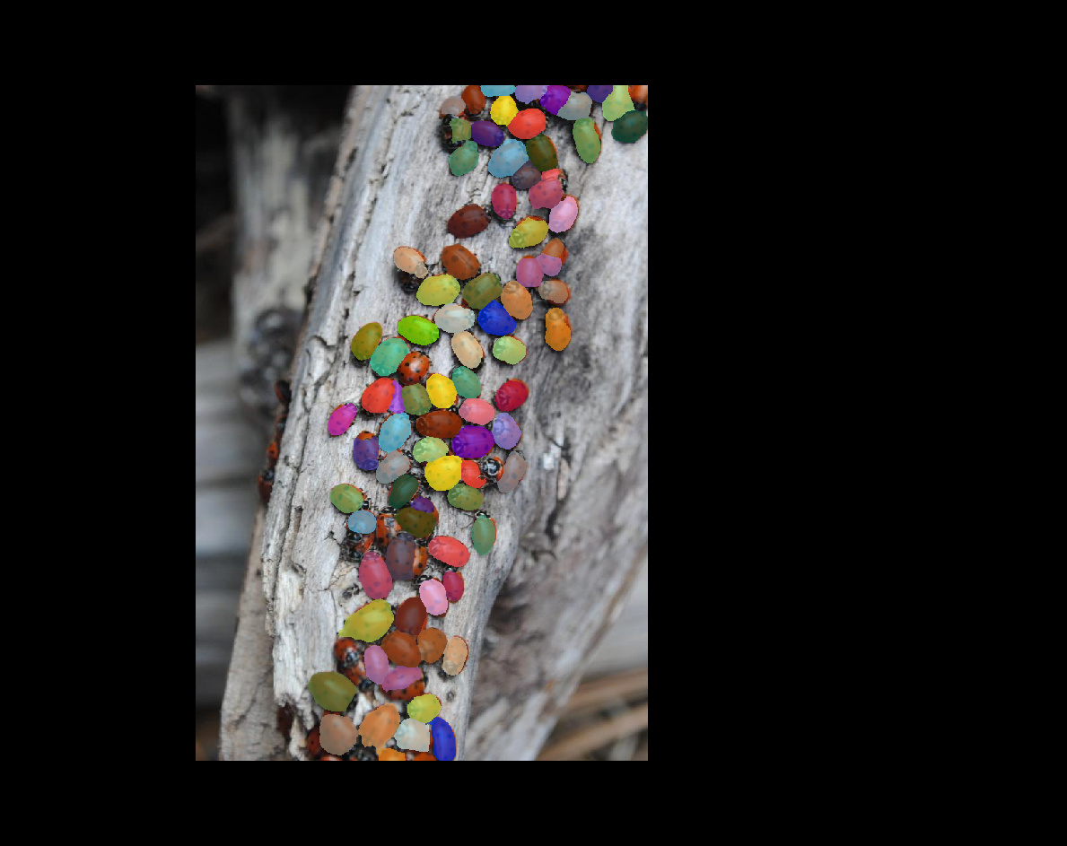

Slide 94
What next ?
only 3 training images !
correct and relabel
bigger training set
train for longer
more training time needed for larger objects ?
consider auto-rescaling ?
consider other models

Slide 95
Segment Everything ?
Can we segment everything with one generalist model ?
maybe someday ?

Slide 96
What is SAM ?
SAM stands for Segment Anything Model.
Prompt based generalist image segmentation.
Prompt is hint
can be a point, bounding box, or even a mask (first guess)

Slide 97
What is SAM ?
Good at detecting overlapping objects (spots on Ladybugs)
multiple prompts -> multiple masks
masks may overlap
if we want 2D label image need to ‘project’ 3D collection to 2D

Slide 98
Viewing and exploring overlapping labels
this example uses mobile SAM and napari-segment-everything

Slide 99
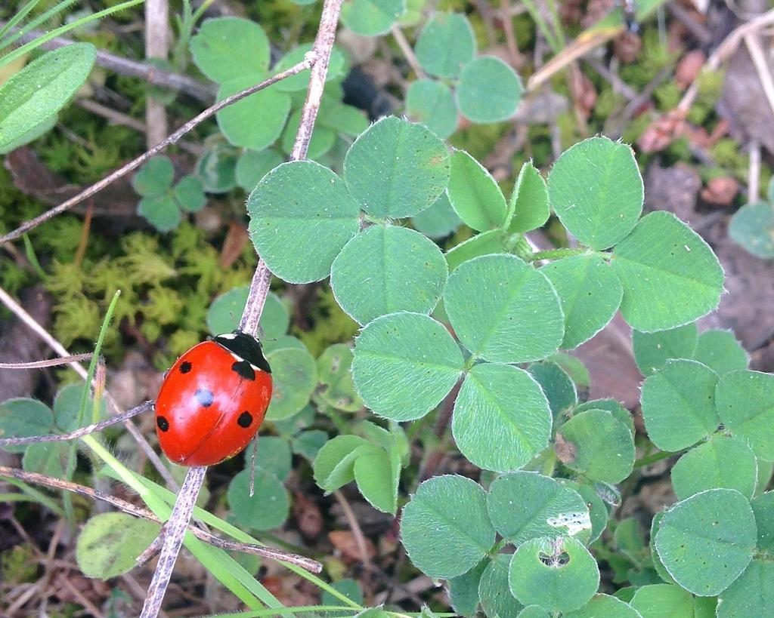
Viewing and exploring overlapping labels

Slide 100
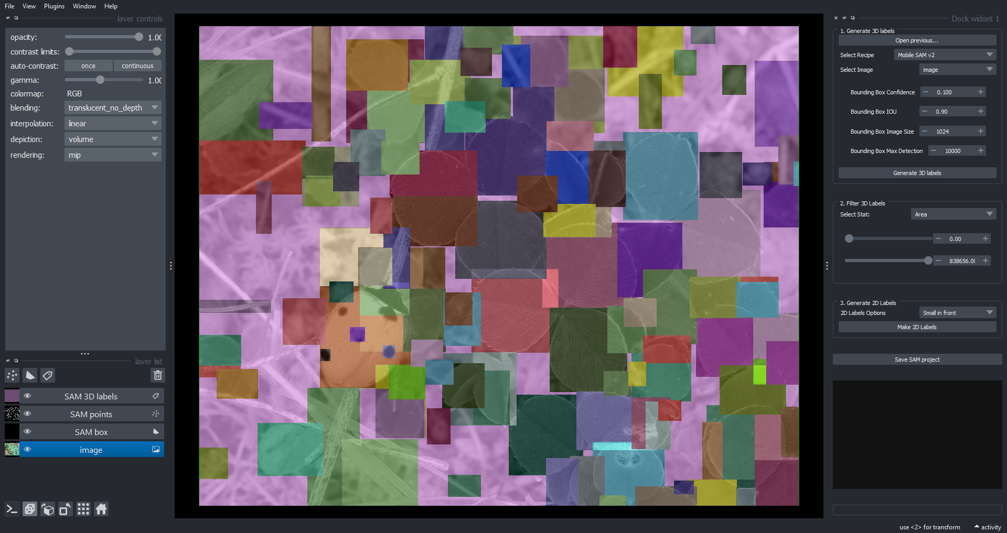
Segment bounding boxes

Slide 101
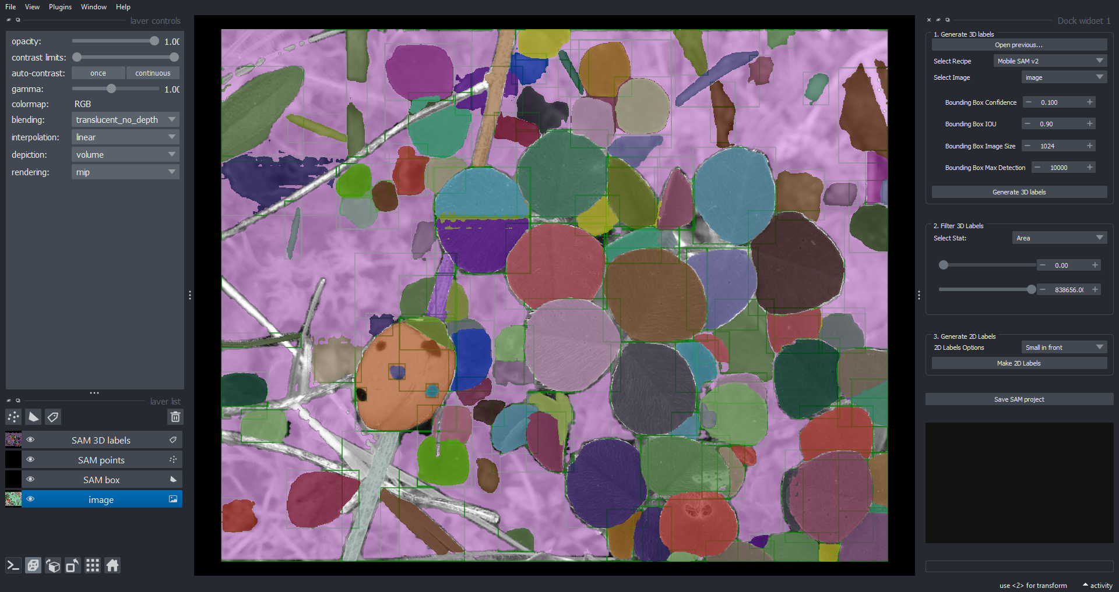
SAM with Yolo bbs as prompt

Slide 102
Rotate to see relationships

Slide 103
Pan and zoom

Slide 104
Filtering Labels
SAM can return hundreds or thousands of labels.
Many of the labels may not be of interest.

Slide 105
Strategies to Filter labels
Train the prompt detector to also classify objects
YOLO can be trained to classify then only keep the prompts corresponding to classes of interest.
Filter the labels by a criteria so we only keep objects of interest.
This example shows the latter strategy.

Slide 106
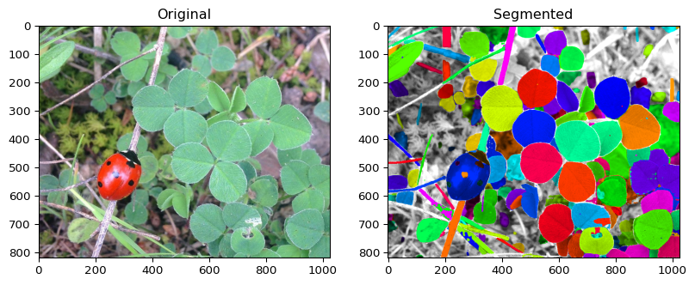
Original and Segmented

Slide 107
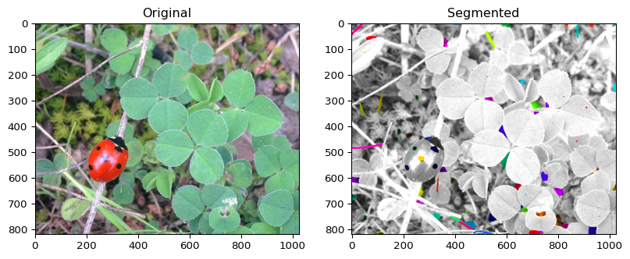
Filter

Slide 109
Look at labels
Overlays

